Slide 1
CGB1201 – JAVA PROGRAMMING
Department of Artificial Intelligence and Data Science
Academic Year: 2024 – 2025 (Odd Semester)
Register Number : 2303811724321103
Name : SHEIKH MOHAMMED M
Year : II
Semester : III
Section : B
Date : 25.11.24

Slide 2
Title of the Project
Digital Clock

Slide 3
Abstract
“A Java-based console application that displays the current time in hours, minutes, and seconds. The clock updates every second and supports both 12-hour and 24-hour formats, as per user preference.”

Slide 4
Introduction
Time is important, but your phone is always busy!
The "Time Keeper: Java Console Clock" is a simple console application that shows the current time and updates every second. Users can select either a 12-hour or 24-hour format. The project uses Java’s Date and Time API and multi-threading for real-time functionality.

Slide 5
Java Programming - Concepts Used
Date and Time API – Using “LocalTime” and “LocalDateTime” to manage and display time.
Loops – Continuous updates using “while” or “for” loops to display real-time time.
Conditionals – “if-else” statements to toggle between 12-hour and 24-hour formats.
Multithreading – Using threads for real-time updates without blocking the program.
User Input Handling – Using “Scanner” to take user preferences for time format.
Exception Handling – Basic error handling for invalid user input.
1. InterruptedException
2. InputMismatchException
3. NumberFormatException

Slide 6
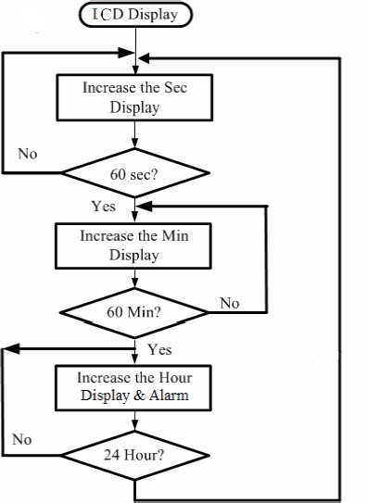
Proposed Architecture

Slide 7
Proposed Architecture - Description
Start Application :
The program begins its execution, initializing necessary components like time retrieval and formatting tools.
Retrieve Time :
The current system time is fetched using the LocalTime.now() method from Java's Date and Time API.
Format Time :
The retrieved time is formatted into a user-friendly format (12-hour or 24-hour) using DateTimeFormatter, based on user preferences.

Slide 8
Proposed Architecture - Description (Cont..)
Display Time :
The formatted time is printed to the console using System.out.print.
Pause Execution :
The program pauses for one second using Thread.sleep(1000) to ensure real-time updates while reducing CPU usage.
Loop Back :
The program loops back to retrieve the updated time and repeats the cycle, ensuring the clock runs continuously.

Slide 9
List of Modules
1.javax.swing (Swing)
2.java.awt (Abstract Window Toolkit)
3.java.text (Formatting)
4.java.util (Utility Classes)
5.java.awt.event (Event Handling)
6.javax.swing.Timer (Optional - Event Scheduling)

Slide 10
Module Description
1.javax.swing (Swing)
Purpose:
Used for creating the graphical user interface (GUI).
Key Classes:
JFrame: Used for creating the main window for the clock.
JLabel: Displays the time and date in the window.
JButton: For adding buttons like "Toggle 12/24-hour format" and "Set Alarm".
2.java.awt (Abstract Window Toolkit)
Purpose: Provides graphical user interface components and event handling.
Key Classes:
BorderLayout: A layout manager for arranging components in five regions.
Font: Used for setting custom fonts to the time and date displays.
3.java.text (Formatting)
Purpose: Used for formatting and parsing dates and times.
Key Classes: SimpleDateFormat: Used for formatting the time and date in a user-friendly format (e.g., HH:mm:ss for time, dd MMM yyyy for date).

Slide 11
Module Description (Cont..)
4.java.util (Utility Classes) java
Purpose: Provides utility classes for handling dates and times.
Key Classes:
Date: Retrieves the current system date and time.
Calendar: Can be used to manage the date and time data if needed for extensions like alarms.
5.java.awt.event (Event Handling)
Purpose: Provides classes to handle user input and events.
Key Classes:ActionListener: Listens for user actions like clicking a button to toggle the time format or set the alarm.
ActionEvent: The event triggered by user interaction with a button.
6.javax.swing.Timer (Optional - Event Scheduling)
Purpose: For scheduling events at fixed intervals, useful for periodic updates to the time display.
Key Classes:Timer: Can be used as an alternative to Thread.sleep() for updating the time every second.

Slide 12

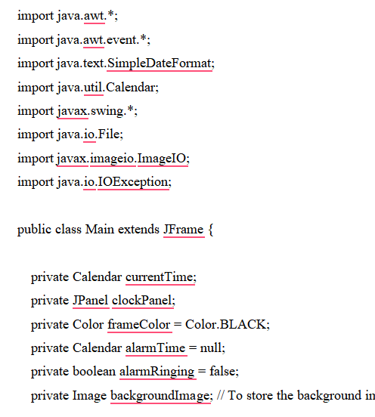
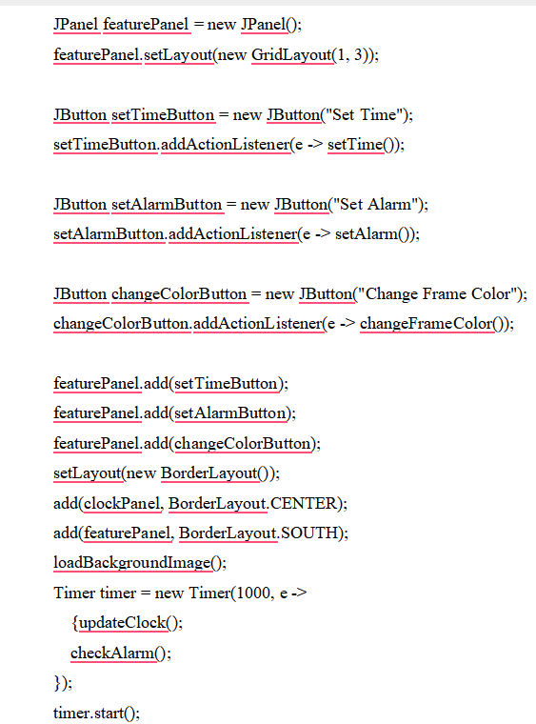
SOURCE CODE

Slide 13
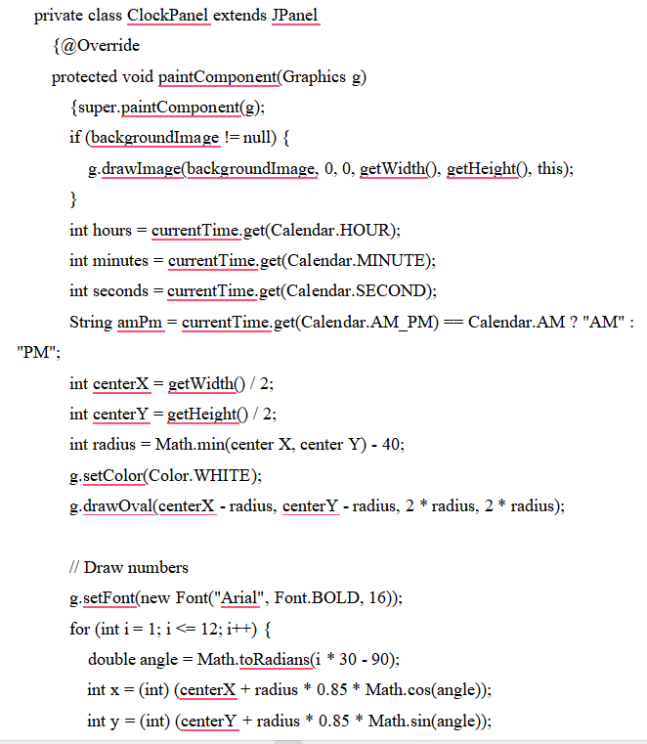
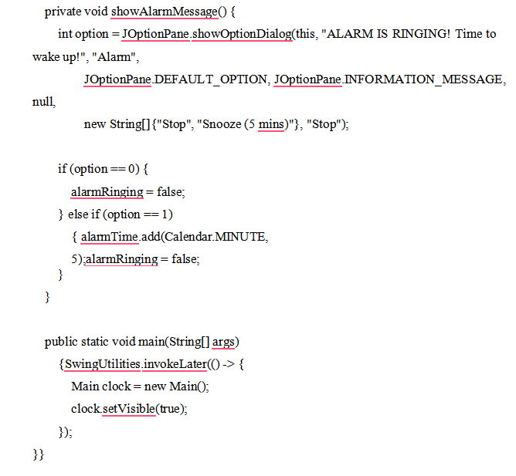
SOURCE CODE

Slide 14
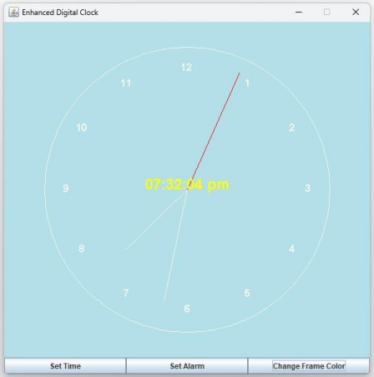
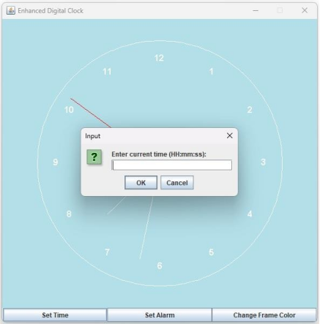
Results and Discussion

Slide 15
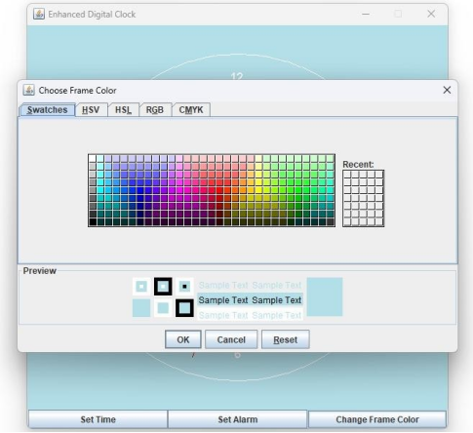
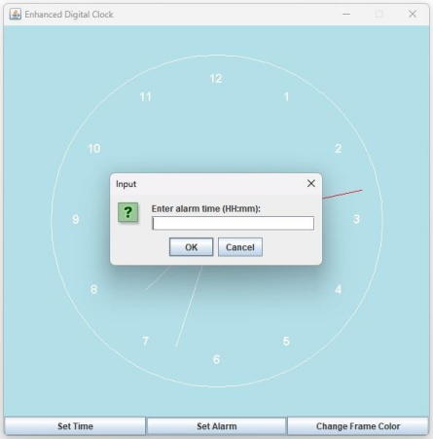
Results and Discussion

Slide 16
Conclusion
This digital clock program effectively displays IST with real-time updates and format flexibility. However, it lacks input validation and an exit option. Adding these features, along with support for multiple time zones or a GUI, could enhance its functionality and user experience.

Slide 17
Thank You
Any queries???

